Slide 1
Sentiment analysis using twitter data
SUBMITTED BY
VATSAL GAMIT (09)
MOHIT TALREJA (32)

Slide 2
1.WHAT IS SENTIMENT ANALYSIS?
INDEX
2.WHY WE USE SENTIMENT ANALYSIS?
3.HOW TO MAKE SENTIMENT ANALYSIS?

Slide 3
1
WHAT IS SENTIMENT ANALYSIS ?

Slide 4
WHAT IS SENTIMENT ANALYSIS ?
“
“ Sentiment analysis is the practice of applying natural language processing and text analysis techniques to identify and extract subjective information from text.”

Slide 5


WHAT IS SENTIMENT ANALYSIS ?
The Process of Analyzing the data in form of text, to extract
Relevant information and transferring it into an useful intelligence
It determines if an information (opinion) is POSITIVE,NEGETIVE OR NEUTRAL based on Normal Human Conversation
This project is an attempt to analyze human emotions to create better experience in different fields

Slide 6
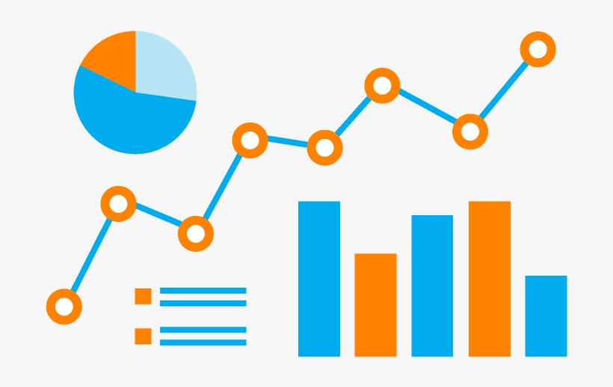
WHAT IS SENTIMENT ANALYSIS ?
This is also called opinion mining because it includes different identifying attributes , emotions , and opinion about the various topics.
During process it gives the value to a word to determine the word’s positivity or negativity.
It helps different sectors by monitoring the sentiments of people about their articles, products or their services
It’s a powerful tool to create trends or to influence the target audience

Slide 7
2
WHY SENTIMENT ANALYSIS ?

Slide 8
WHY SENTIMENT ANALYSIS ?
Its estimated that 80% of the worlds data is unstructured ! Most of this comes from text data, like emails, chats, social media, articles, and documents. These texts are usually difficult to analyze, understand and sort.
Sentiment analysis allows us to make sense of this large sea of data by saving our time of manual data processing.
Social Media Marketing
Brand Monitoring
Trend Making
Customer Services
Market Research
Security Analysis
Prediction Making

Slide 9
3
HOW TO MAKE SENTIMENT ANALYSIS ?

Slide 10
WORKFLOW
Here we are using the sentiment analysis on Twitter Data using python programming language.
1.COLLECTING DATA FROM TWITTER
2.CLEANING THE DATA(OR PREPOCESSING)
3.APPLYING THE RIGHT SENTIMENT ANALYSIS ALGORITHM
4.PLOTING THE RESULTS ON GRAPH AND ANALYZING THE RESULT
5.IMPROVEMENTS

Slide 11
HOW TO GET DATA(TWEETS) FROM TWITTER

